Slide 1
Lab: Concurrent and Distributed Systems Himeno Benchmark and Mandelbrot Set
Colloquium
Fritz Louis Wilke
fritz.wilke@tu-dresden.de
4536116
M. Sc. Computer Science

Slide 2
Agenda
The Mandelbrot Set
Problem
(Unoptimized) Algorithm
Optimizations
Evaluation
The Himeno Benchmark
Problem
(Unoptimized) Algorithm
Optimizations
Evaluation
Summary

Slide 3

The Mandelbrot Set
https://commons.wikimedia.org/wiki/File:Mandel_zoom_00_mandelbrot_set.jpg

Slide 4
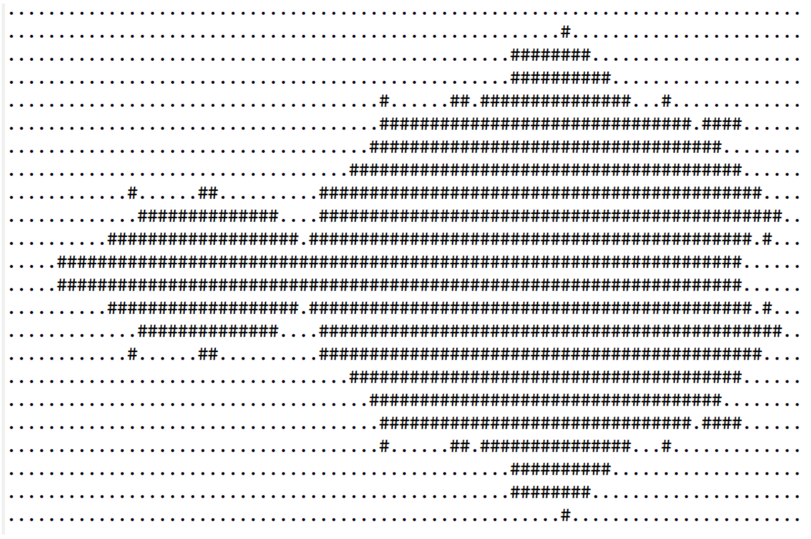
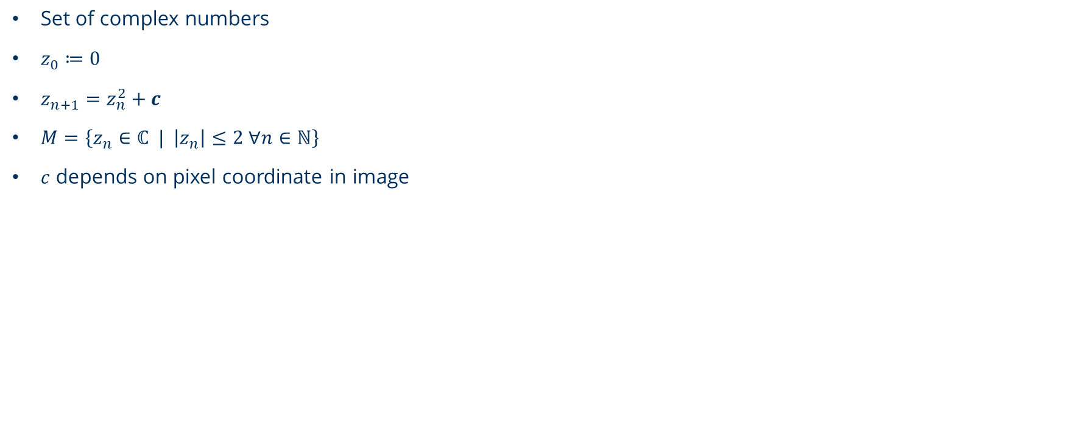
Problem The Mandelbrot Set
Set of complex numbers
$z_{0}≔0$
$z_{n+1}=z_{n}^{2}+c$
$M=\left\{z_{n}∈ℂ | \left|z_{n}\right|≤2 ∀n∈ℕ\right\}$
$c$ depends on pixel coordinate in image

Slide 5
Unoptimized Algorithm The Mandelbrot Set
input: uint rows, uint cols, uint nn
output: char[]
begin
let img = char[rows][cols]
for r in 0..rows:
for c in 0..cols:
let z = complex(0, 0)
let n = 0
while |z| < 2.0 and n < nn:
z = z*z + complex( c*2 / cols – 1.5, r*2 / rows – 1.0 )
n = n + 1
img[r][c] = (n == nn) ? ´#´ : ´.´
for r in 0..rows:
for c in 0..cols: print( img[r][c] )
print( ´\n´ )
end

Slide 6
Optimizations The Mandelbrot Set
General:
Simplifying calculations
Working directly with floats instead of std::complex<float>
Storing and reusing interim results
Working on continuous memory (as image)
Parallelization:
Parallelize the pixel calculation (inner for loop)
Provide and collect work dynamically via queues
Aligning data structures to fit cache lines
Each worker thread has one input- and output queue

Slide 7

Parallel Workflow The Mandelbrot Set
calculate
pixel
INPUT QUEUE
WORKER THREAD
OUTPUT QUEUE
INPUT THREAD
INPUT QUEUE
WORKER THREAD
OUTPUT QUEUE
OUTPUT THREAD
pull pixel
results
push pixel
numbers
INPUT QUEUE
WORKER THREAD
OUTPUT QUEUE

Slide 8
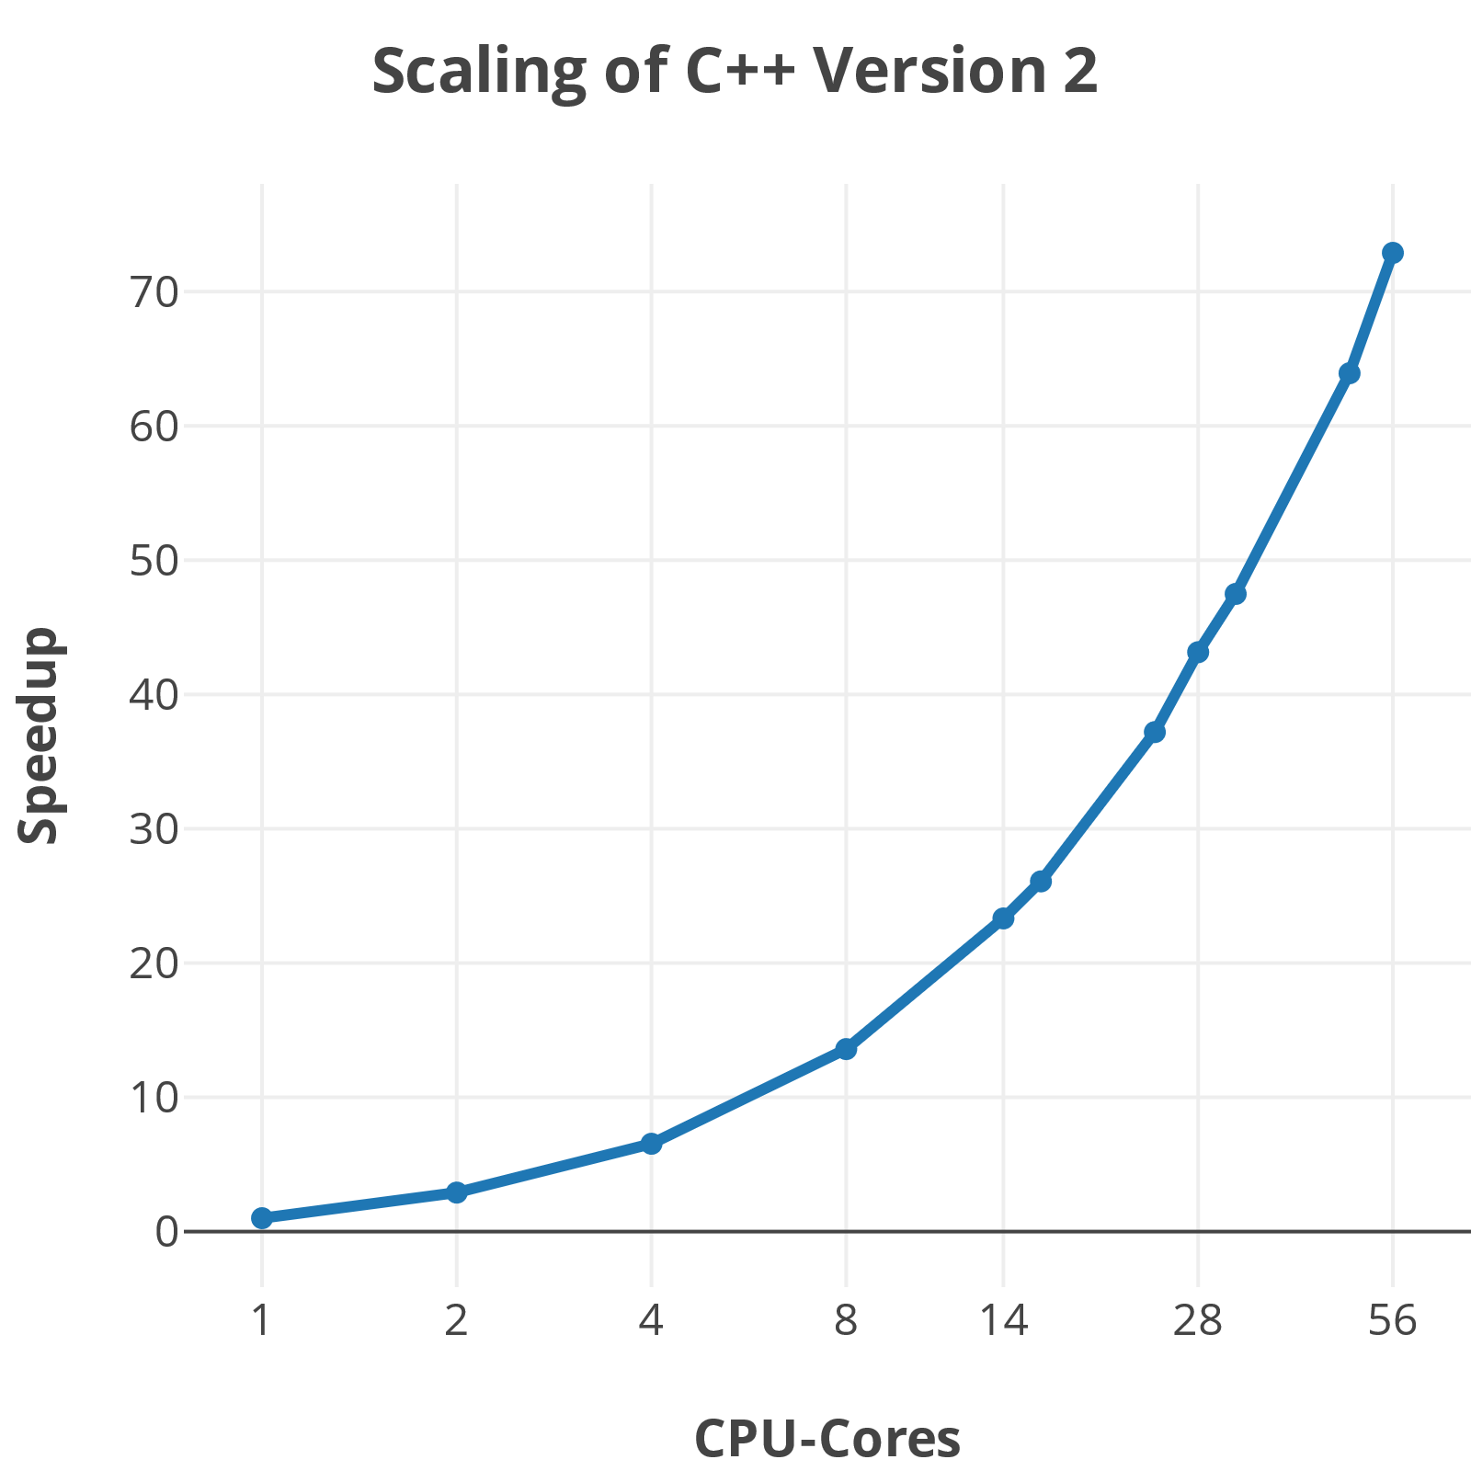
Evaluation The Mandelbrot Set
Unoptimized code as reference
C++ and C#
Scaled very well
No decline after 14 or 28 cores due to local queues
Parallel code amount over 100% (not realistic)
Lang. | V | Optimization | Time | Abs. | Rel.
C++ | 0 | Unmodified | 207050 | 1x | 1x
 | 1 | I/O Threads | 2182 | 86x | 83x
 | 2 | + Simplified | 263 | 716x | 73x
C# | 0 | Unoptimized | 63332 | 1x | 1x
 | 2 | Both | 452 | 146x | 1798x
Notes:
- No decline after 14 or 28 cores since every thread has its own local queue. This prevents blocking due to simultaneous access on the queues when using many threads

Slide 9

The Himeno Benchmark
http://www.isum2017.udg.mx/es/contenido/dr-ryutaro-himeno

Slide 10
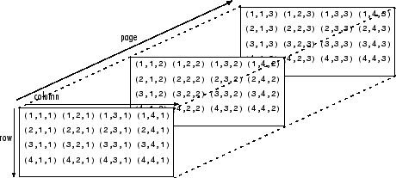
Problem The Himeno Benchmark
A benchmarking program
Extremely memory intensive
Uses the Jacobi method for calculations
Works on several 4D-Matrices, where first 3 dimensions are same size
http://www.isum2017.udg.mx/es/contenido/dr-ryutaro-himeno

Slide 11
Unoptimized Algorithm The Himeno Benchmark
input: uint rows, uint cols, uint deps, uint nn
output: float
begin
initialize_matrices()
let gosa
for n in 0..nn:
gosa = 0.0
for r in 1..rows-1: // iterate over every voxel
for c in 1..cols-1:
for d in 1..deps-1:
let ss = jacobi_iteration(r, c, d)
gosa += ss*ss
wrk2[0][r][c][d] = p[0][r][c][d] + 0.8*ss
wrk2.copy_to(p) // copy content of p to wrk2
print( gosa ) // print result (with a precision of 6)
end

Slide 12
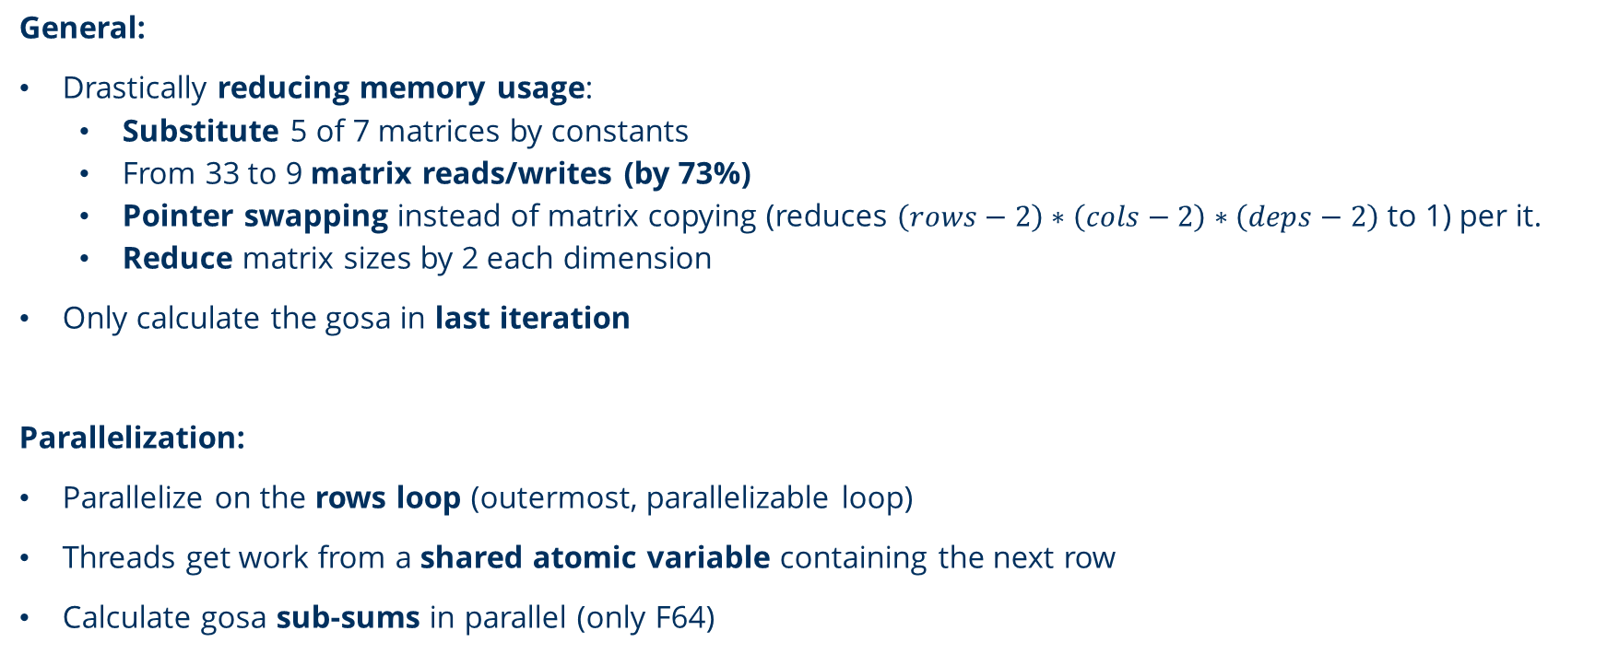
Optimizations The Himeno Benchmark
General:
Drastically reducing memory usage:
Substitute 5 of 7 matrices by constants
From 33 to 9 matrix reads/writes (by 73%)
Pointer swapping instead of matrix copying (reduces $\left(rows−2\right)∗\left(cols−2\right)∗\left(deps−2\right)$ to 1) per it.
Reduce matrix sizes by 2 each dimension
Only calculate the gosa in last iteration
Parallelization:
Parallelize on the rows loop (outermost, parallelizable loop)
Threads get work from a shared atomic variable containing the next row
Calculate gosa sub-sums in parallel (only F64)
Notes:
raw threads
nn loop is not parallelizable
invalid result using F32 for gosa sub-sums

Slide 13


Parallel Workflow The Himeno Benchmark
Start
Create matrices
Modify Gosa
Stop
no
Join threads
yes
$$n<nn$$
$$n==nn −1$$
yes
no
yes
Create t threads
Work (in parallel)
Work
done?
no

Slide 14
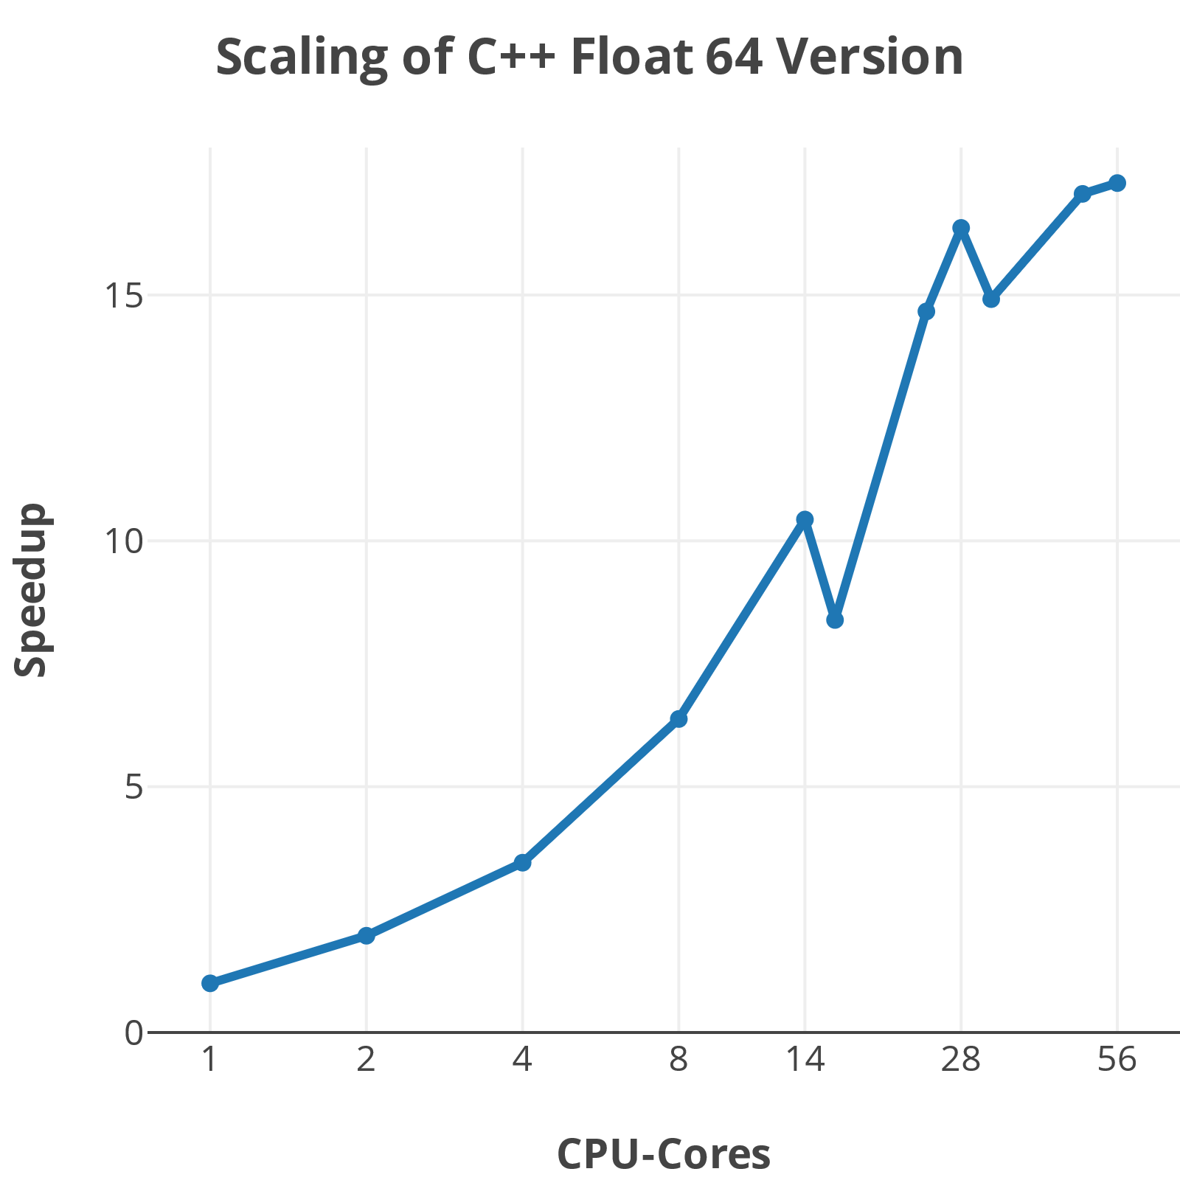
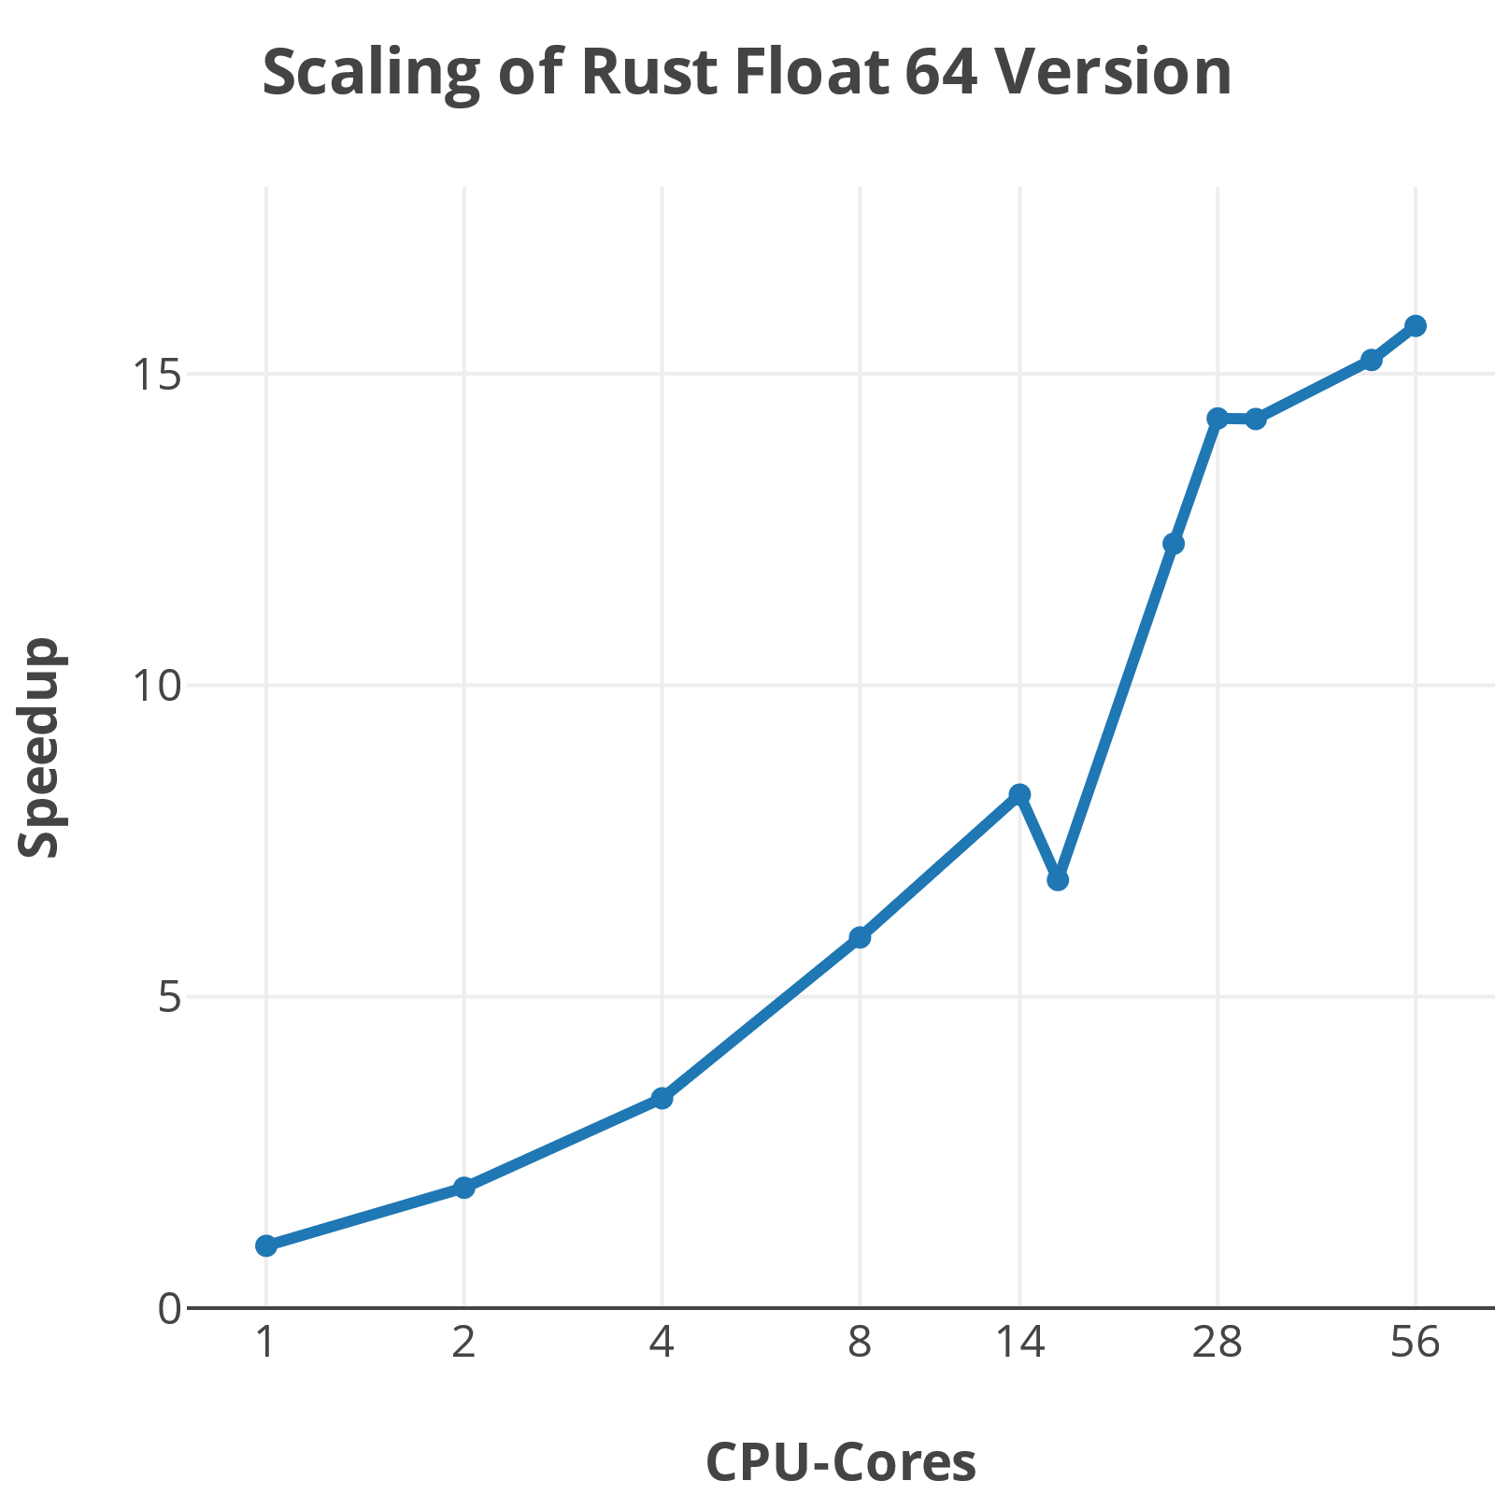
Evaluation The Himeno Benchmark
Unoptimized code as reference
C++ and Rust
Scaled ok (w.r.t. the high memory usage)
Strong decline at 16 and 32 cores
Parallel code up to 97.37%
Lang. | FXX | Optimization | Time | Abs. | Rel. | p @ 28 | p @ 56
C++ | 32 | Unmodified | 171978 | 1x | 1x | 0% | 0%
 |  | Parallel | 34346 | 5x | 10x | 93.46% | 91.91%
 | 64 | Unmodified | 207050 | 1x | 1x | 0% | 0%
 | 64 | Parallel | 19294 | 10x | 17x | 97.37% | 95.92%
Rust | 64 | Unoptimized | 289943 | 1x | 1x | 0% | 0%
 | 64 | Parallel | 7108 | 43x | 16x | 96.44% | 95.36%

Slide 15
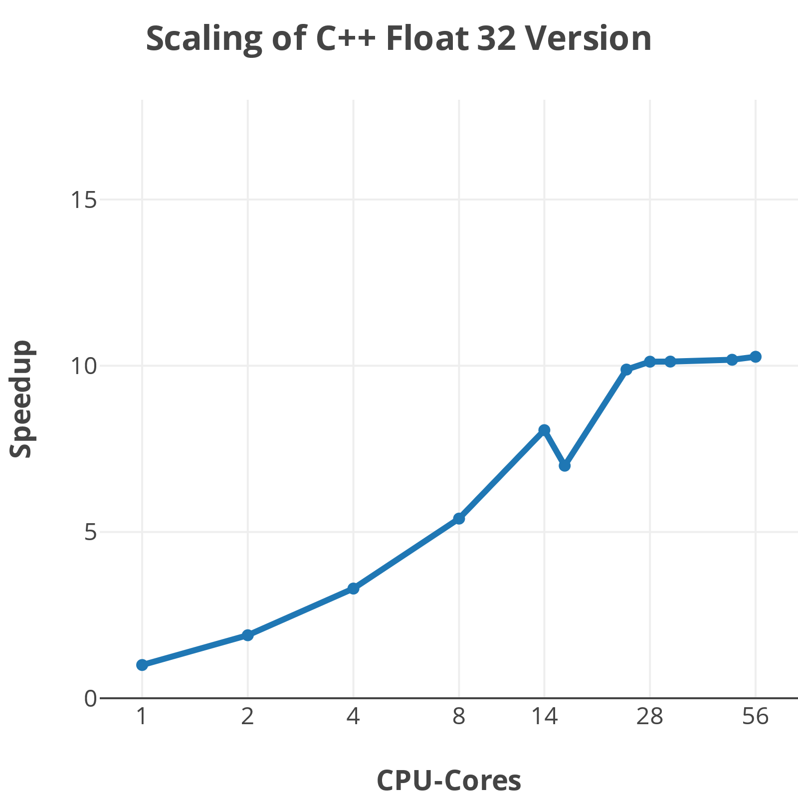
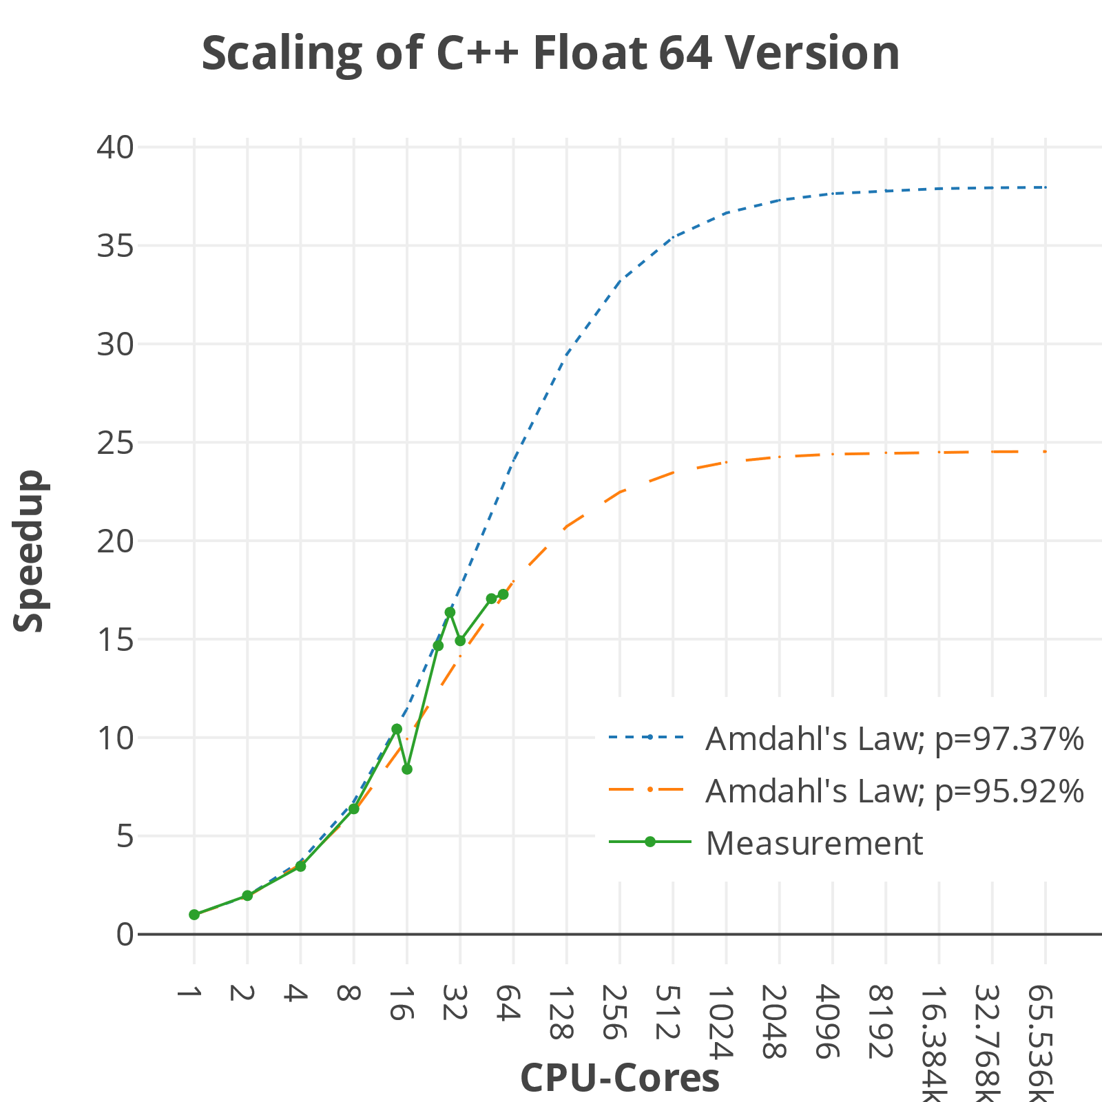
Evaluation The Himeno Benchmark

Slide 16
Summary
Solved workload distribution with queues and atomic variables
Optimized and simplified the algorithms
Speedup of 1798 (716 abs.) for the Mandelbrot Set, optimal goal was 51
Speedup of 17 (43 abs.) for the Himeno Benchmark, optimal goal was 13
Learned about memory throughput and cache invalidation as limiting factor
Notes:
Memory as limiting factor, inter-socket communication (core ➔ core) or even intra-socked communication (CPU socket ➔ CPU socket)

Slide 17
Thank you for your attention!
Questions?
Improvements?
How did others solve the tasks?

Slide 18

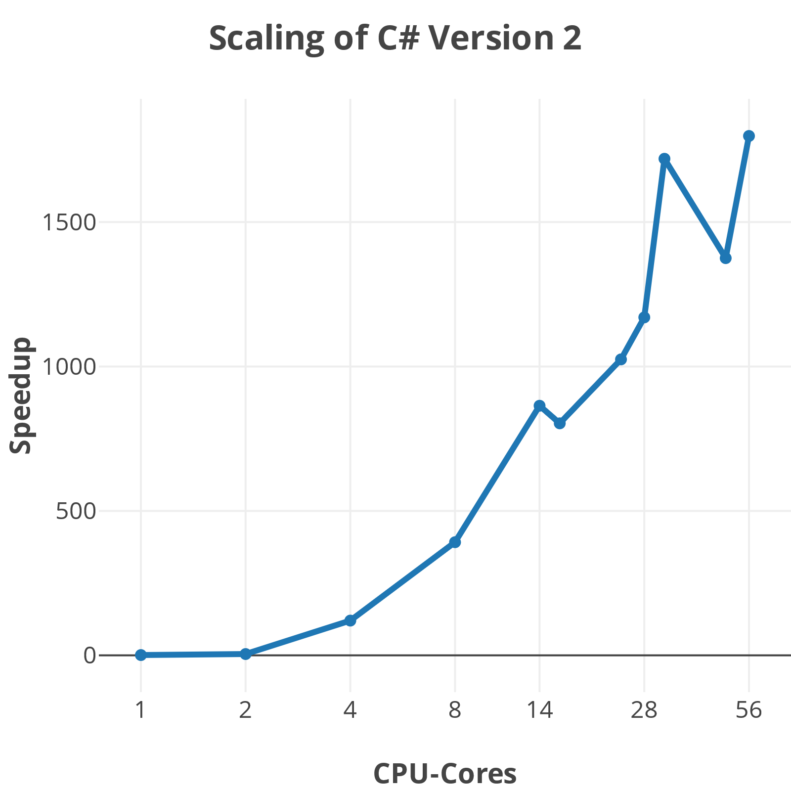
Scaling of all Versions The Mandelbrot Set

Slide 19
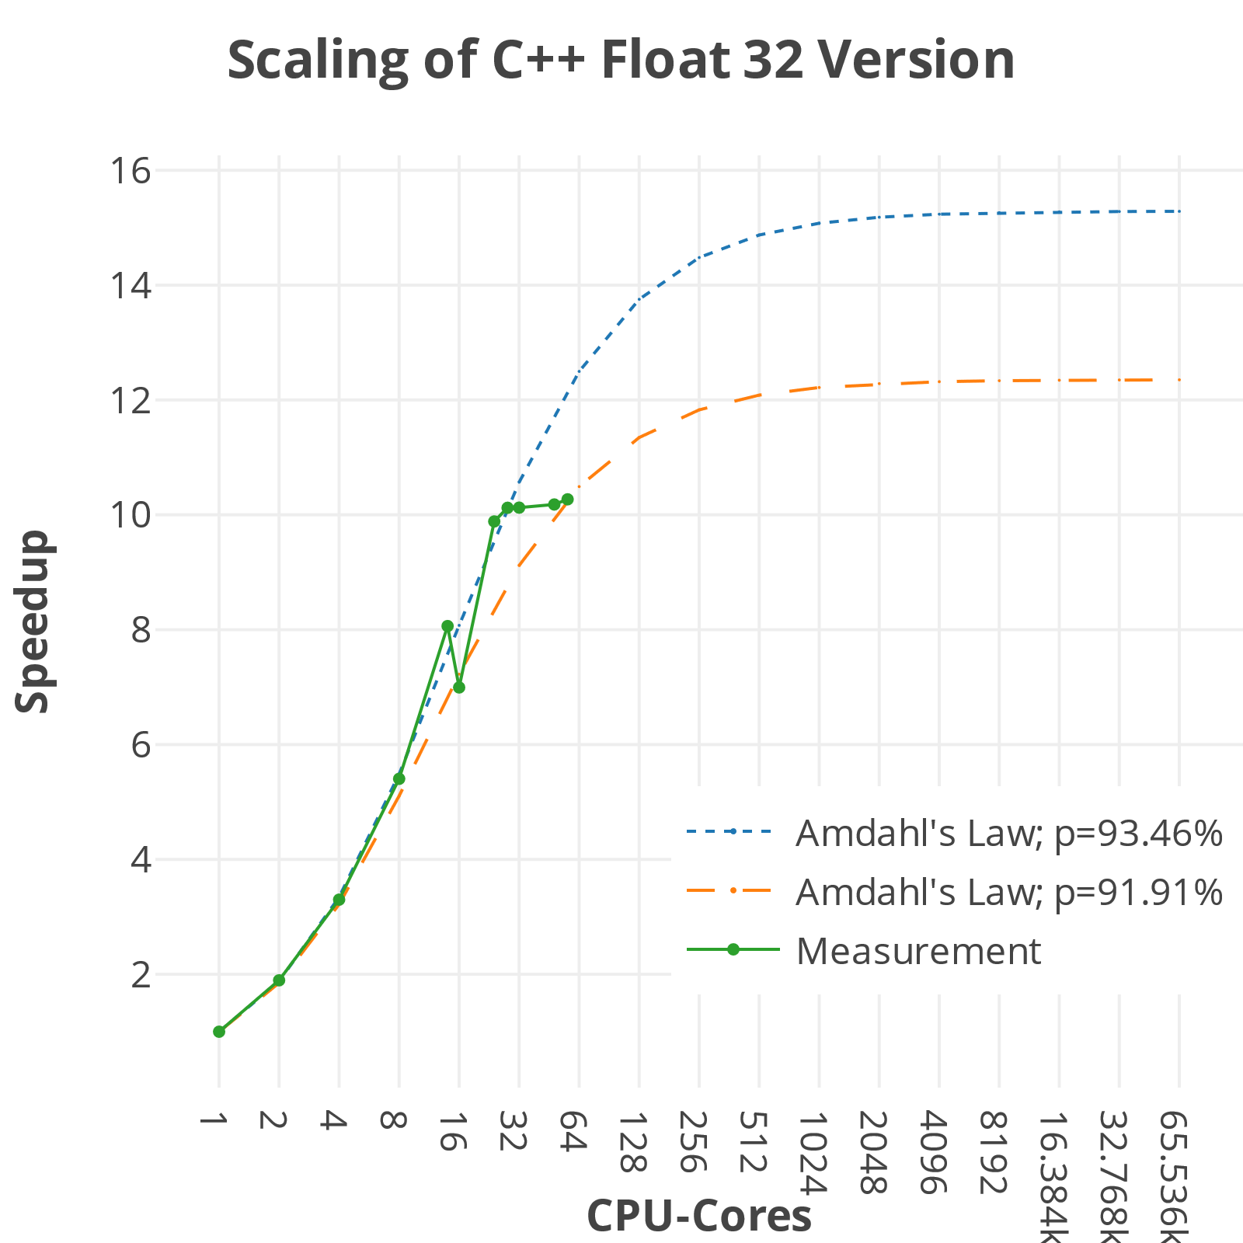
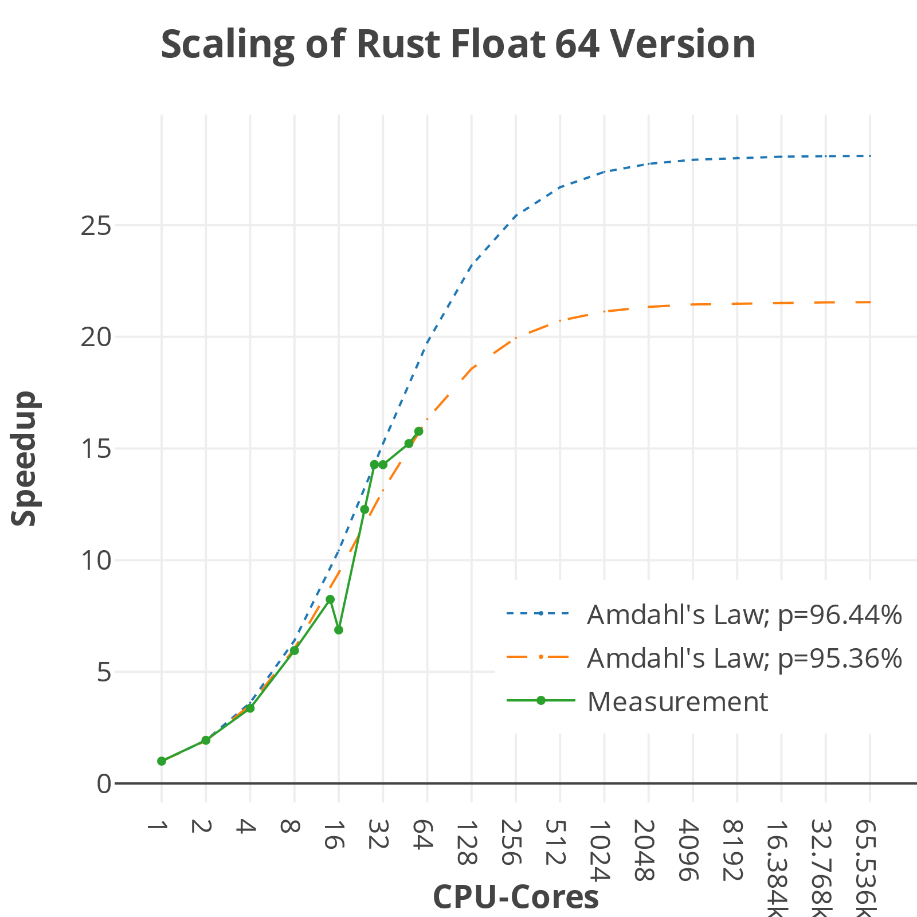
Scaling with Amdahl’s Law of all Versions The Himeno Benchmark

